Slide 1

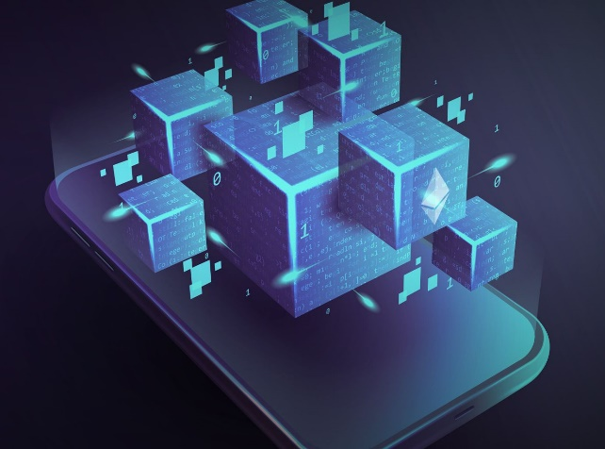

WEEKLY STATUS REPORT
IoT Blockchain and Its Application in Logistics
Week 7 – 8
Mentor: Nguyen Xuan Thong
Reporter: Thanh Tung – Thanh Phuong

Slide 2

Contents
01 Gradle & GUI Java
02 Embark – WebUI & WebDApp
03 Demo
04 Work plan of this week

Slide 3
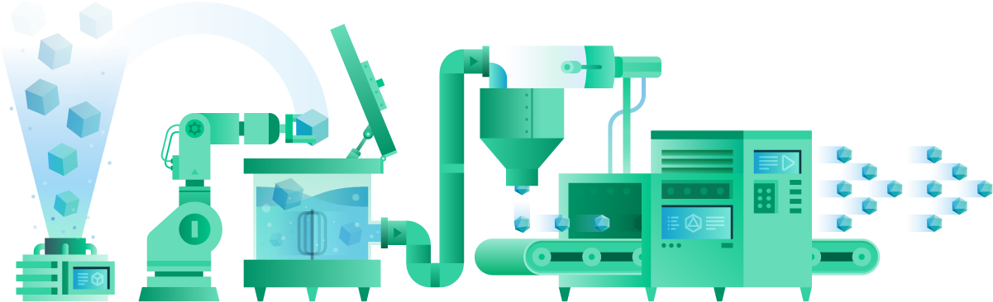
01
Part One
Gradle & GUI Java

Slide 4


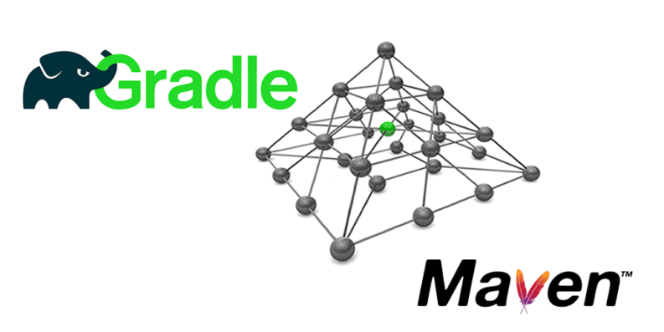
1-1 What is Gradle?
Gradle is an open-source build automation system that builds upon the concepts of Apache Ant and Apache Maven and introduces
a Groovy-based domain-specific language (DSL) instead of the XML form used by Apache Maven for declaring the project configuration. Gradle uses a directed acyclic graph ("DAG") to determine the order in which tasks can be run.

Slide 5


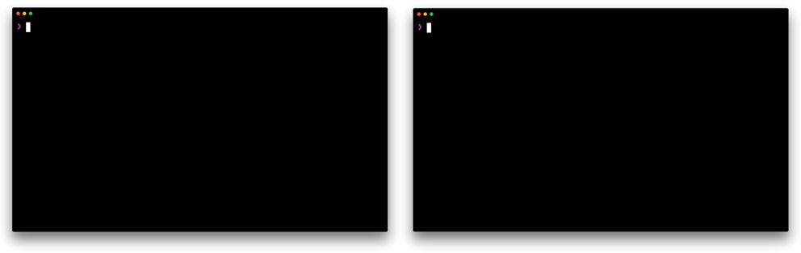

1-1 What is Gradle?
Gradle is an open-source build automation tool focused on flexibility and performance. Gradle build scripts are written using a Groovy or Kotlin DSL.

Slide 6

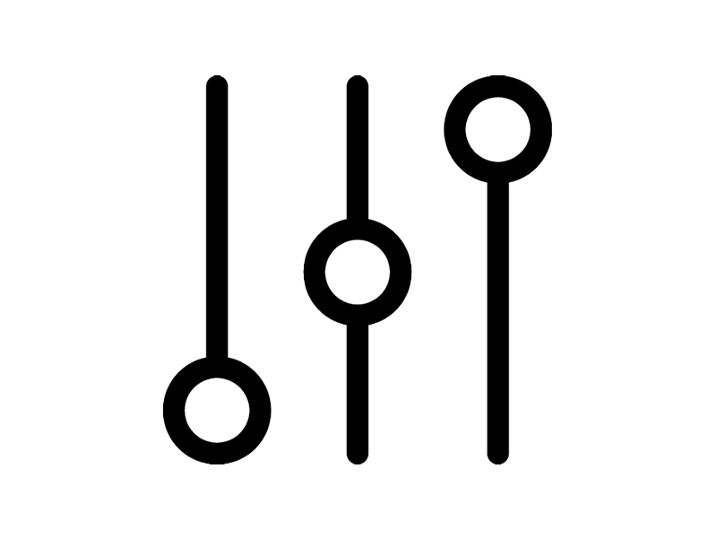


1-2 Why we choose Gradle?
Highly customizable — Gradle is modeled in a way that is customizable and extensible in the most fundamental ways.
Fast — Gradle completes tasks quickly by reusing outputs from previous executions, processing only inputs that changed, and executing tasks in parallel.
Powerful — Gradle is the official build tool for Android, and comes with support for many popular languages and technologies.
Newest - easier to use.
build.xml -> easy to know. (compare with Maven)
Has ability to control and manage source code with Ethereum Blockchain and (.sol) file.

Slide 7
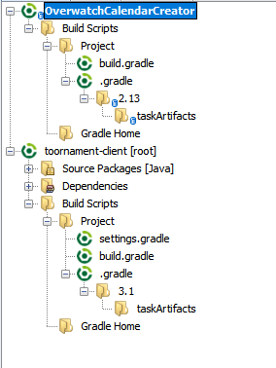
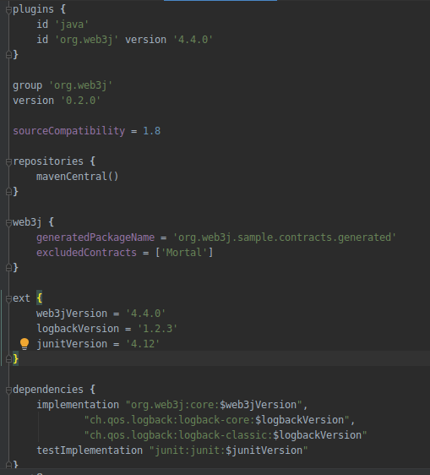

1-3 Gradle – How it works?
compile ('org.web3j:core:4.4.0')
gradle.build

Slide 8
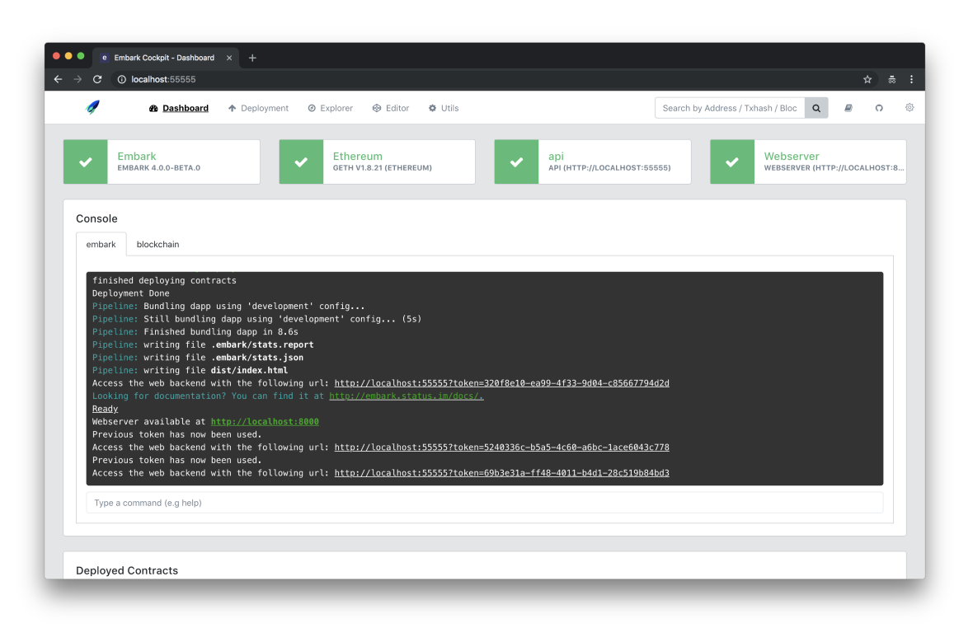

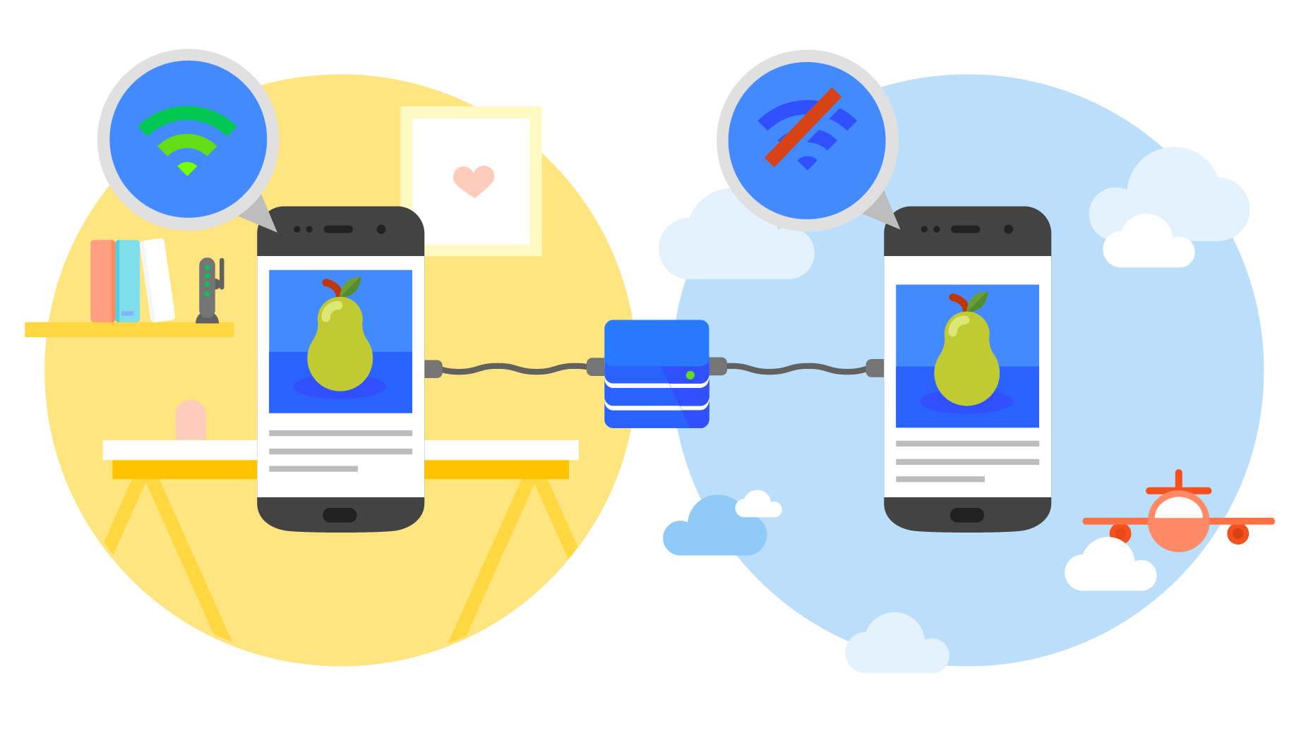
02
Part Two
Embark – WebUI & WebDApp

Slide 9



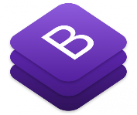
2-1 WebApp
html
Create a basic WebApp
Input field for inputing barcode of product.
Input field for testing the map and location.
Information table.
Map area.
javascript
css
Bootstrap

Slide 10
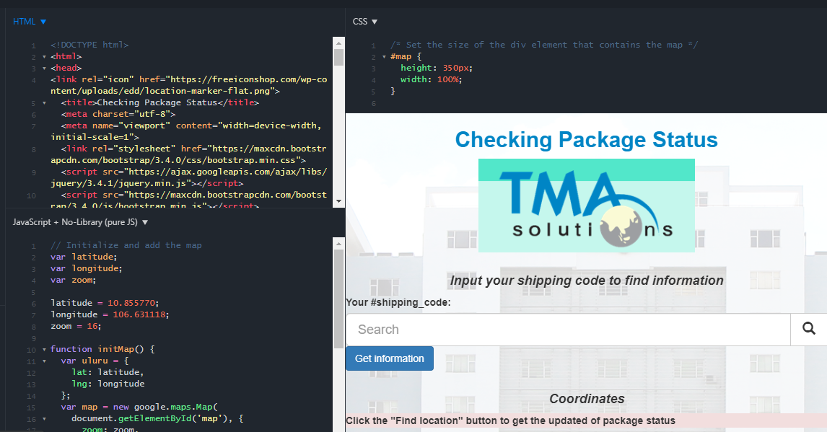
2-1 WebApp
html
css
javascript
WebApp Panel

Slide 11


2-2 Hosting WebApp to an online Address
http://tma-batch26-testnet.rf.gd

Slide 12


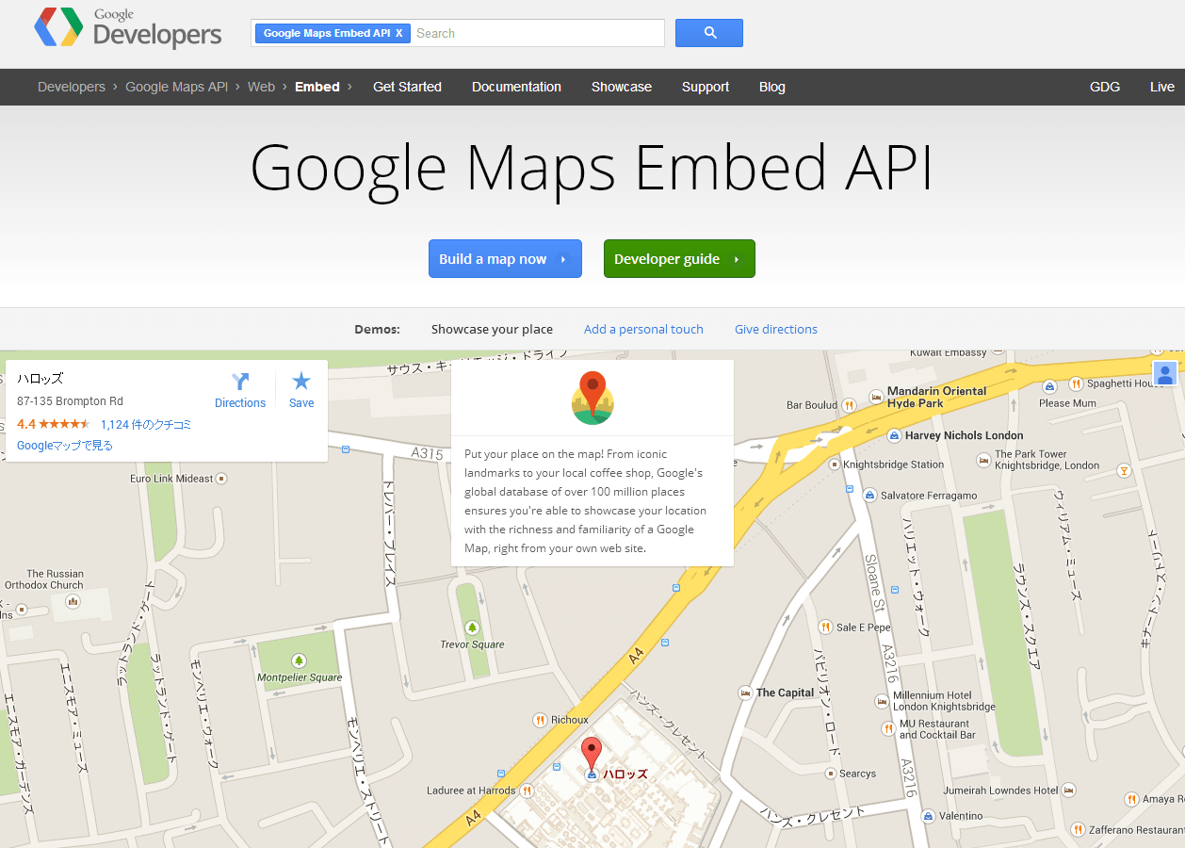
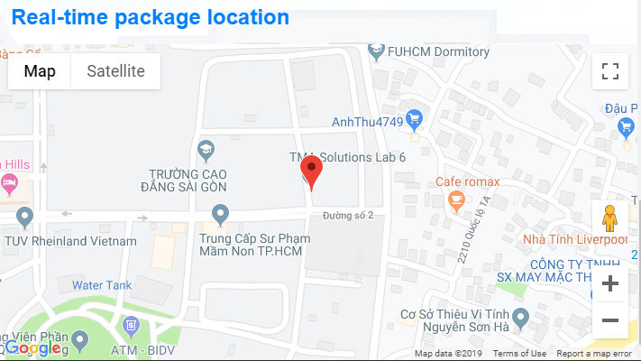
2-3 Using Google Map Embed API

Slide 13

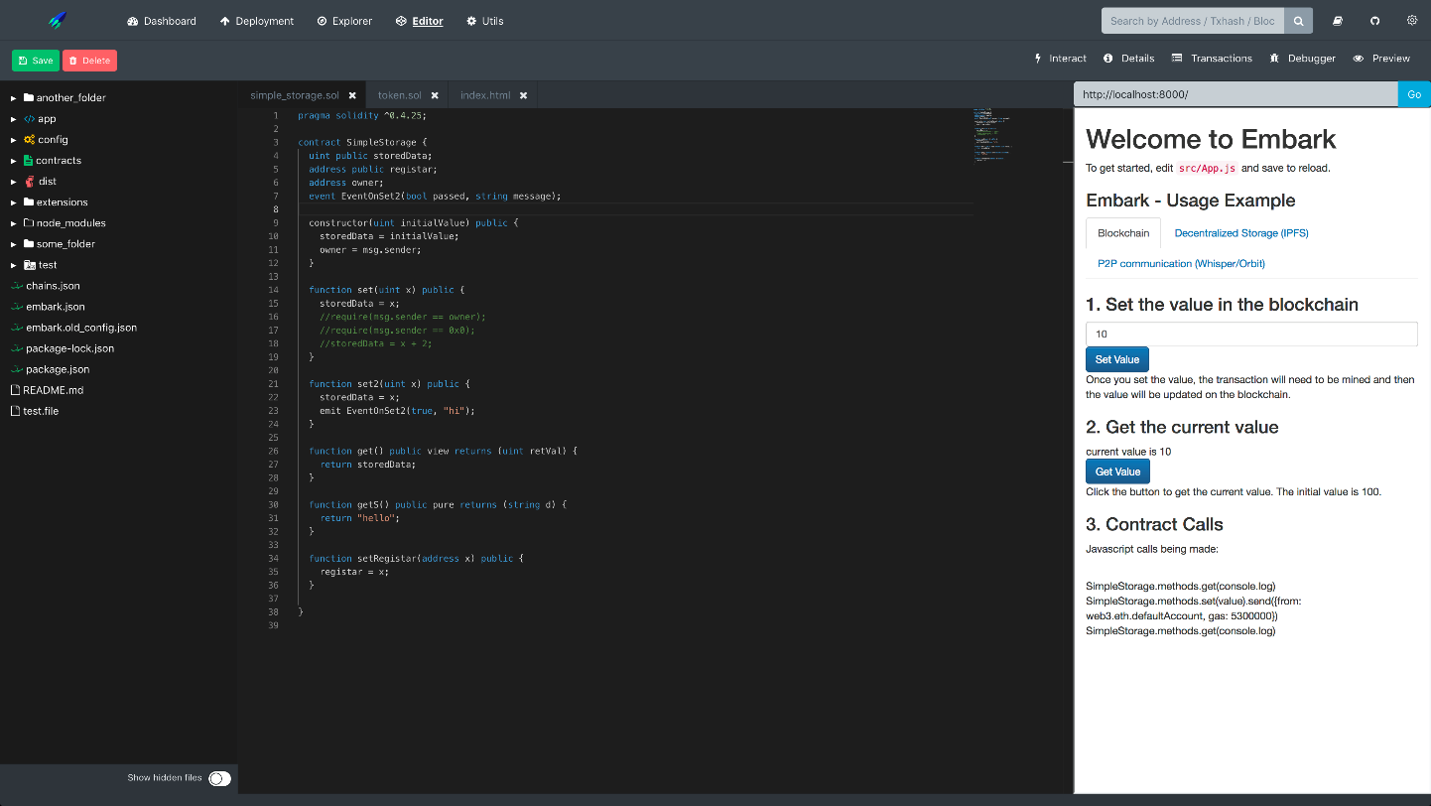

2-4 Embark & WebDApp
Ethereum Blockchain
Embark CLI

Slide 14
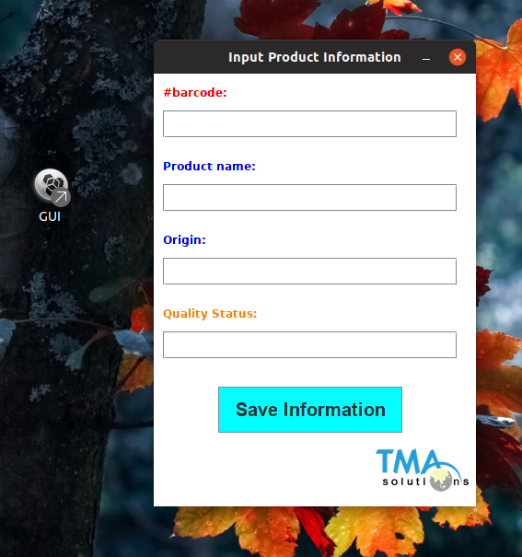
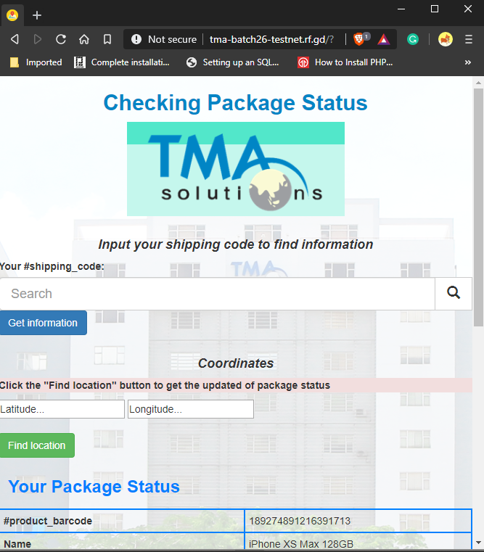

03
Part Three
DEMO

Slide 15
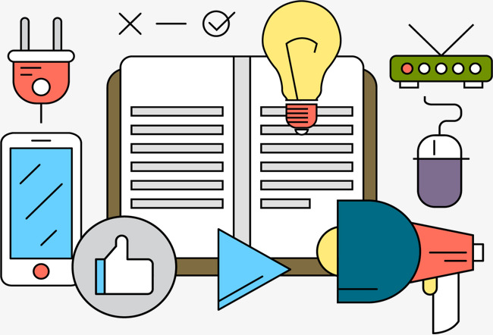
04
Part Four
Work plan of this week

Slide 16
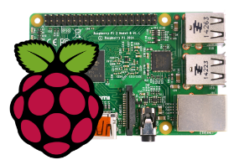


4 Work Plan
How to using barcode for updating information from Raspberry Pi
Completing DApp …
57%
Find the way to get information from EthBC to WebUI
43%

Slide 17
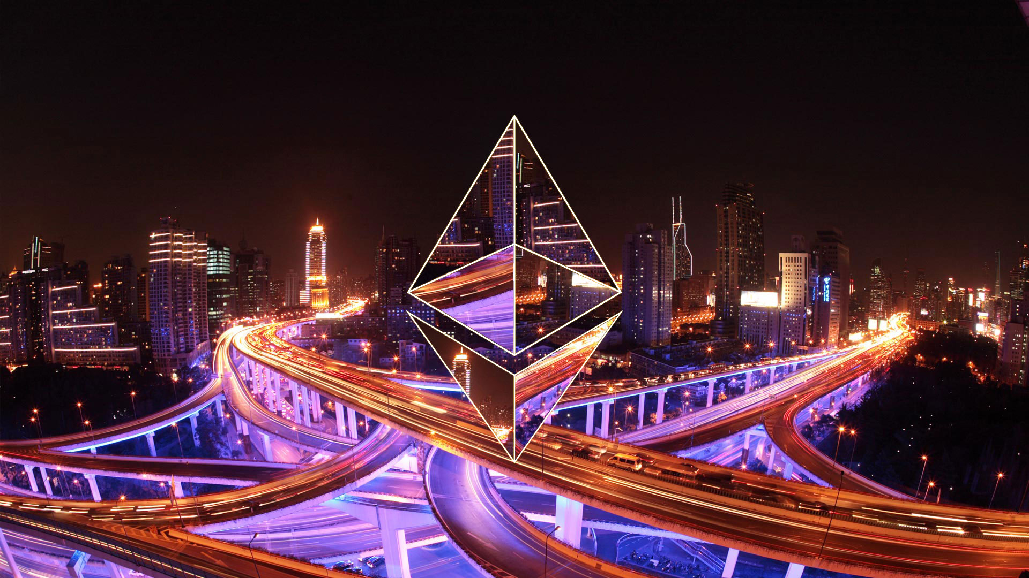
Week 7 – 8
THANK YOU FOR YOUR LISTENING

